Slide 1
Report on Nigerian Economy
Presented by Maggie Huang

Slide 2
Country Profile (the World Bank):
Level of development | developing
Region | Sub-Saharan Africa
Land (Wikipedia) | 923,768
Income Group: | Lower middle income
Population* (Wikipedia) | 188.7 million
* It is the largest country in Africa and accounts for 47 per cent of West Africa’s population. (Top 10)
* It is the biggest oil exporter in Africa and has the largest natural gas reserves in the continent. (Top 10)

Slide 3
Economic Outlook in 2018 (the World Bank)
Areas | Value | World rank | The world average
Inflation | 16.5 | 6/231 | 4.6
Unemployment | 7.03 | 93/233 | 7.37
Real GDP (trillion) | 1.12 | 22/220 | 0.67
GDP per capita ($) | 5875 | 170/235 | 20358
Rate of economy growth (%) | 0.81 | 216/241 | 3.4
Real GNI | 1.09 | 24/190 | 0.74

Slide 4
1. GDP (the World Bank)
1.1 Real GDP in Nigeria
2007 | 2008 | 2009 | 2010 | 2011 | 2012 | 2013 | 2014 | 2015 | 2016 | 2017
0.61 | 0.66 | 0.72 | 0.79 | 0.85 | 0.90 | 0.98 | 1.06 | 1.10 | 1.09 | 1.12

Slide 5
1.1 Real GDP in Nigeria

Slide 6
1.2 GDP per capita
2007 | 2008 | 2009 | 2010 | 2011 | 2012 | 2013 | 2014 | 2015 | 2016 | 2017 | 2018
4163 | 4414 | 4679 | 4980 | 5212 | 5386 | 5684 | 5990 | 6053 | 5875 | 5875

Slide 7
1.3 Rate of Economic Growth
2007 | 2008 | 2009 | 2010 | 2011 | 2012 | 2013 | 2014 | 2015 | 2016 | 2017 | 2018
6.59 | 6.76 | 8.04 | 8.01 | 5.31 | 4.23 | 6.67 | 6.31 | 2.65 | -1.62 | 0.81

Slide 8
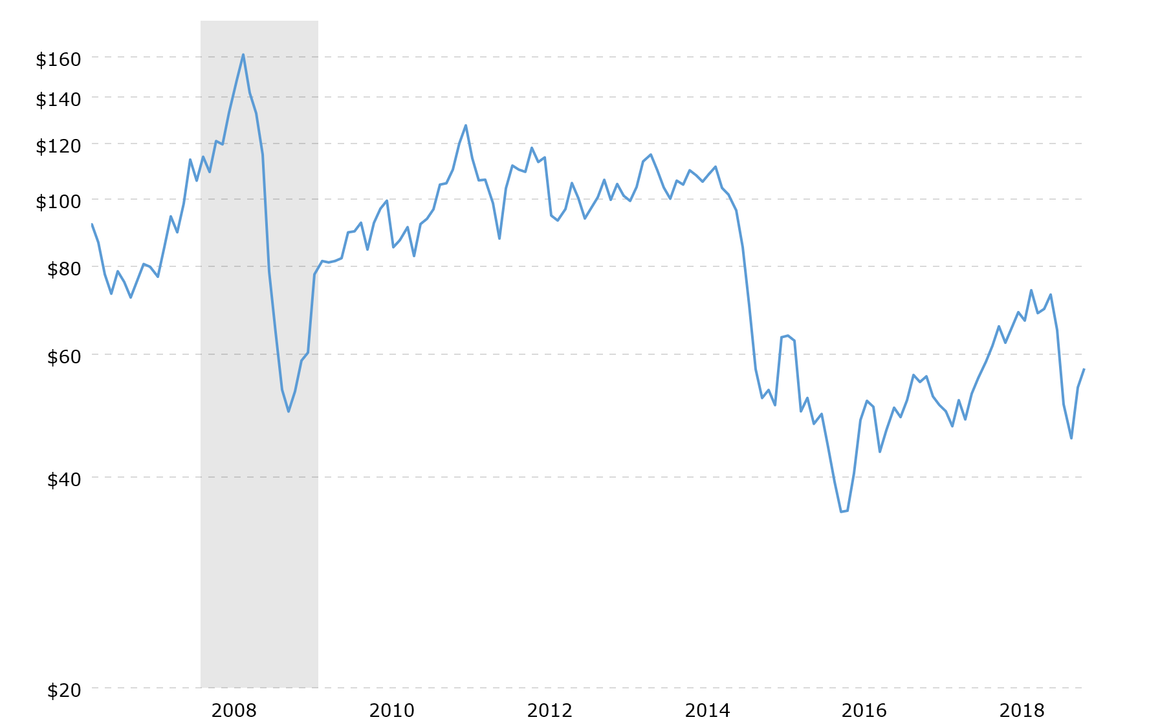
Crude oil prices over the decade (Crude Oil):

Slide 9
2. Unemployment
2.1 unemployment rate in Nigeria
(the World Bank)
2007 | 2008 | 2009 | 2010 | 2011 | 2012 | 2013 | 2014 | 2015 | 2016 | 2017
4.048 | 3.971 | 3.899 | 3.826 | 3.761 | 3.7 | 4.56 | 4.31 | 7.06 | 7.043 | 7.026

Slide 10
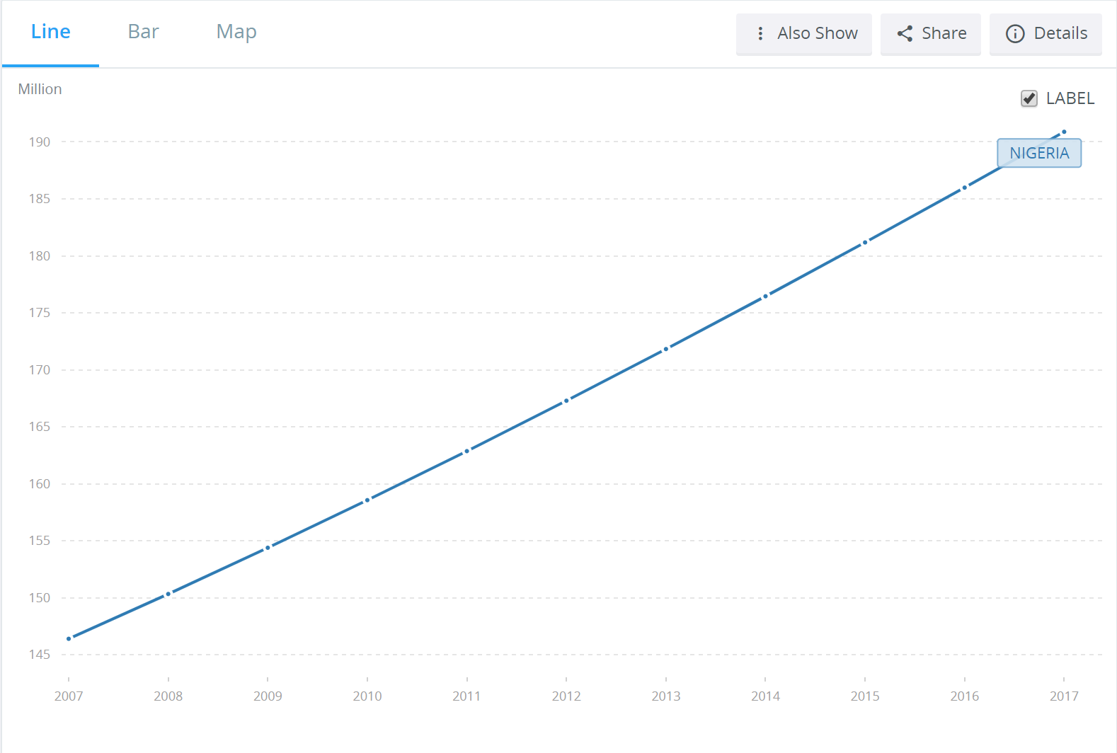
The population over the last decade:

Slide 11
2.2 Do all people seem to be equally affected by unemployment?

Slide 13
3. Inflation
3.1 Nigeria’s rate of inflation
2007 | 2008 | 2009 | 2010 | 2011 | 2012 | 2013 | 2014 | 2015 | 2016 | 2017
5.38 | 11.6 | 11.5 | 13.7 | 10.8 | 12.2 | 8.48 | 8.06 | 9.01 | 15.7 | 16.5

Slide 14
Question: Will inflation be a major concern for Nigeria?

Slide 15
4. REAL GNI
2008 | 2009 | 2010 | 2011 | 2012 | 2013 | 2014 | 2015 | 2016 | 2017
0.63 | 0.69 | 0.75 | 0.80 | 0.86 | 0.93 | 1.02 | 1.07 | 1.07 | 1.09

Slide 16
Comparison with GDP:

Slide 17
Comparison (2017)
Criteria | Value | World rank | The world average | The first | The value for the first | The last one | The value for the last
Inflation | 16.5 | 6/231 | 4.6 | South Sudan | 188 | Saudi Arabia | -0.8
Unemployment | 7.03 | 93/233 | 7.37 | Lesotho | 28 | Qatar | 0.121
Real GDP (trillion) | 1.12 | 22/220 | 0.67 | China | 23.3 | Tuvalu | 0.00004
GDP per capita ($) | 5875 | 170/235 | 20358 | Qatar | 128374 | Central African Republic | 725
Rate of economy growth (%) | 0.81 | 216/241 | 3.4 | Libya | 26.7 | Dominica | -9.5
Real GNI | 1.09 | 24/190 | 0.74 | China | 23.2 | Tuvalu | 0.00006

Slide 18
Question: Real GDP ranking consistent with its per capita GDP ranking?
GDP ranking: 22
GDP per capita: 170

Slide 19
Question: why GDP and GNI ranking is different
Definition from the World Bank:
“GNI is the sum of value added by all resident producers plus any product taxes (minus subsidies) not included in the valuation of output plus net receipts of primary income (compensation of employees and property income) from abroad.”

Slide 20
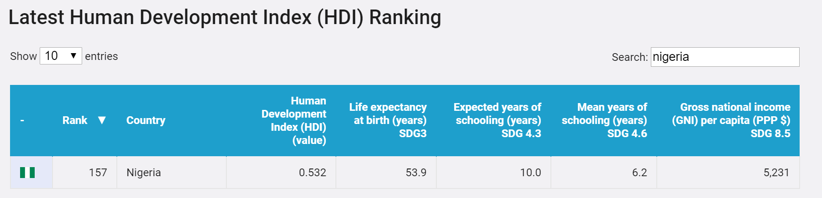
5. HDI
comparison to GDP per capita?

Slide 21
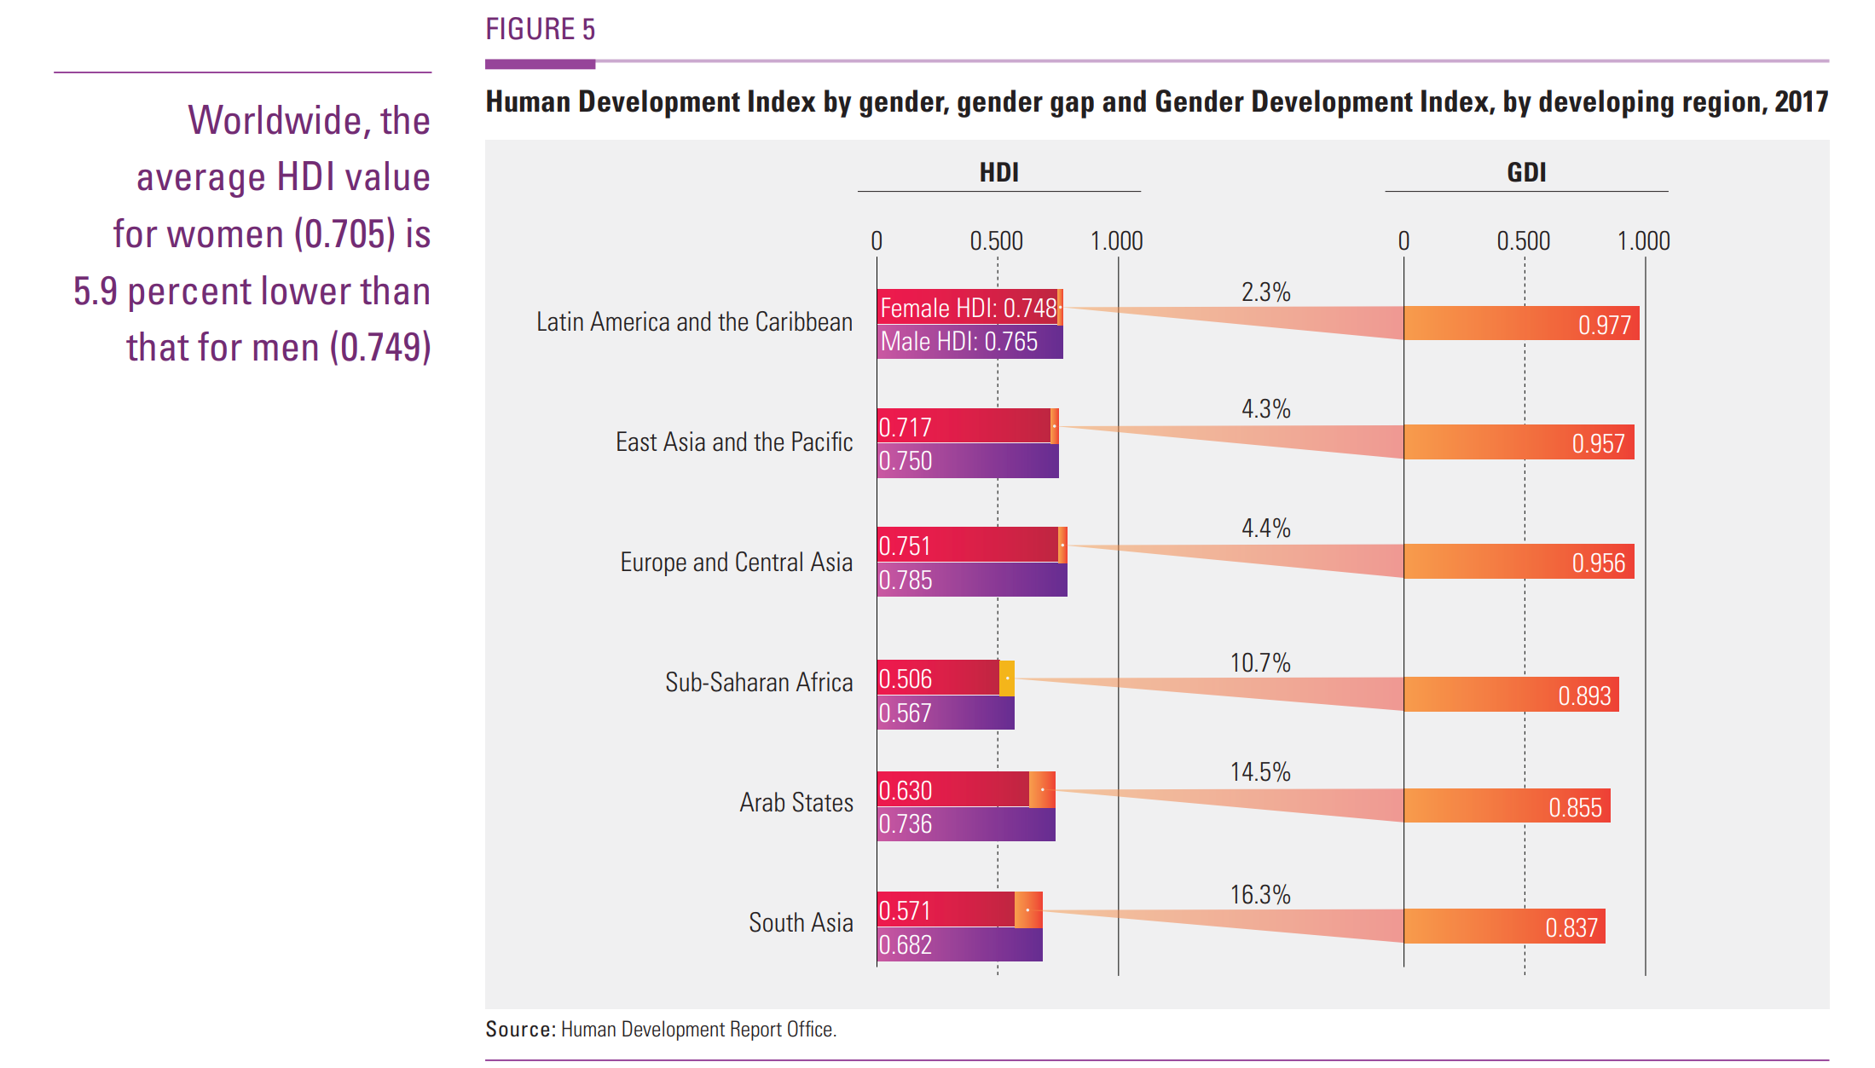
measure of gender inequality.

Slide 22
In Nigeria,
the HDI for female is 0.458,
ranked 152/187;
HDI for male is 0.503,
ranked also 152/187
(Human Develop Report).

Slide 23
7. MDG (ECA)
Goal 1: Eradicate extreme poverty and hunger.

Slide 24
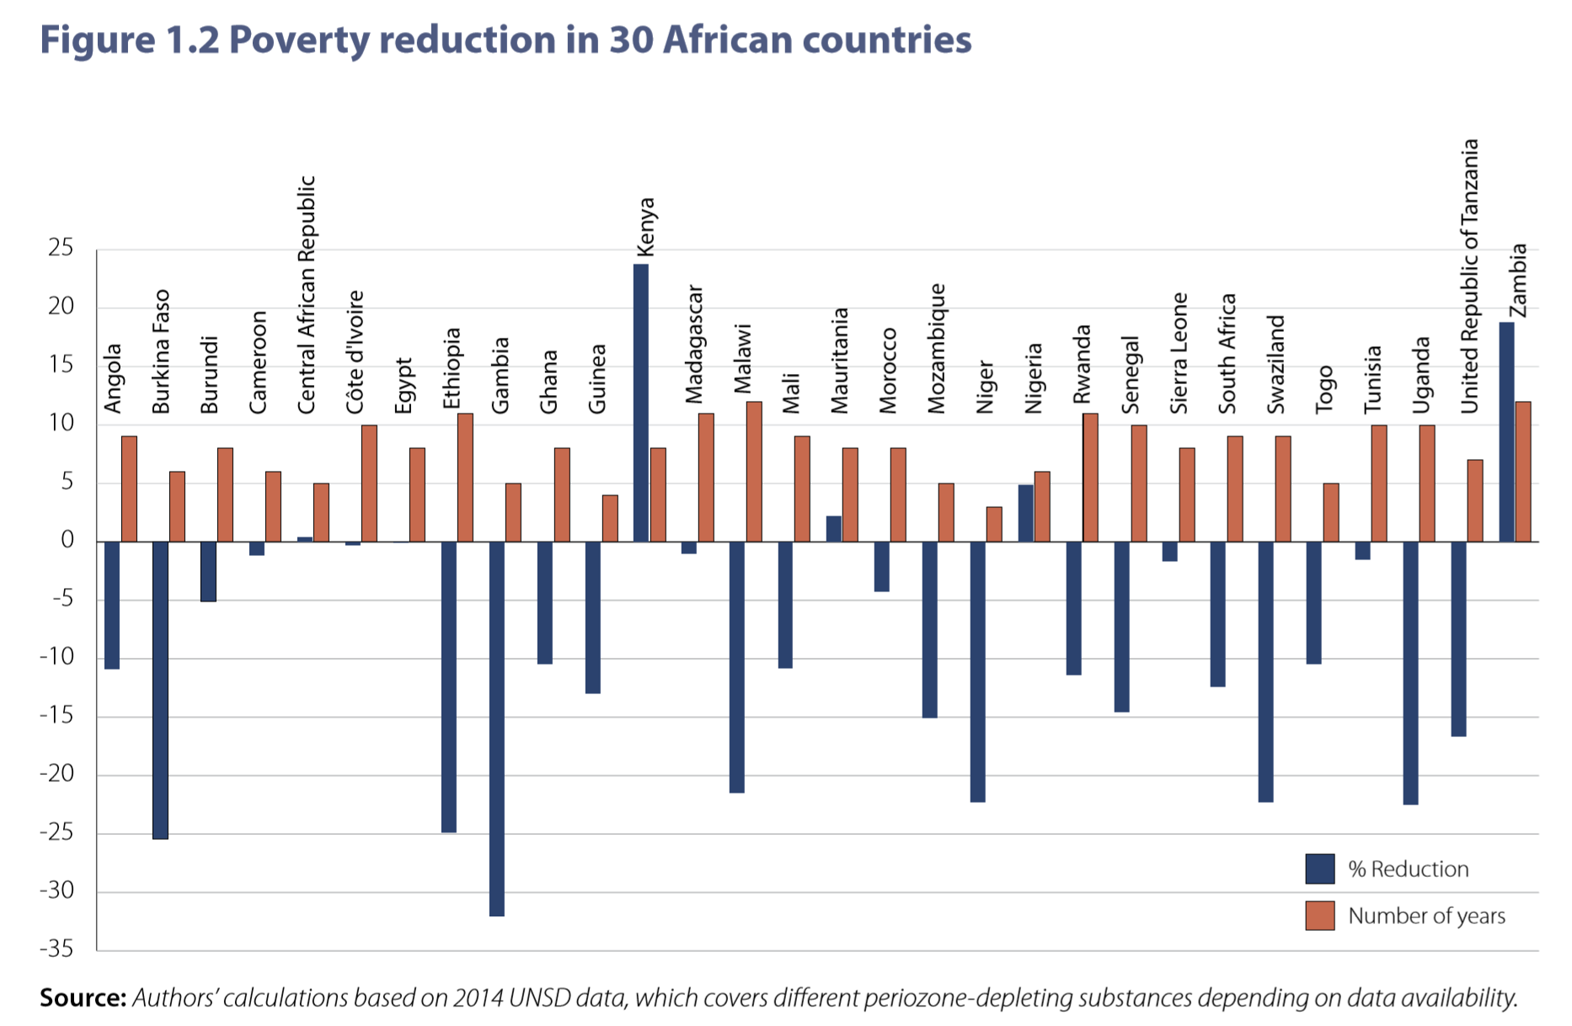
No progress, and even increasing poverty.

Slide 25
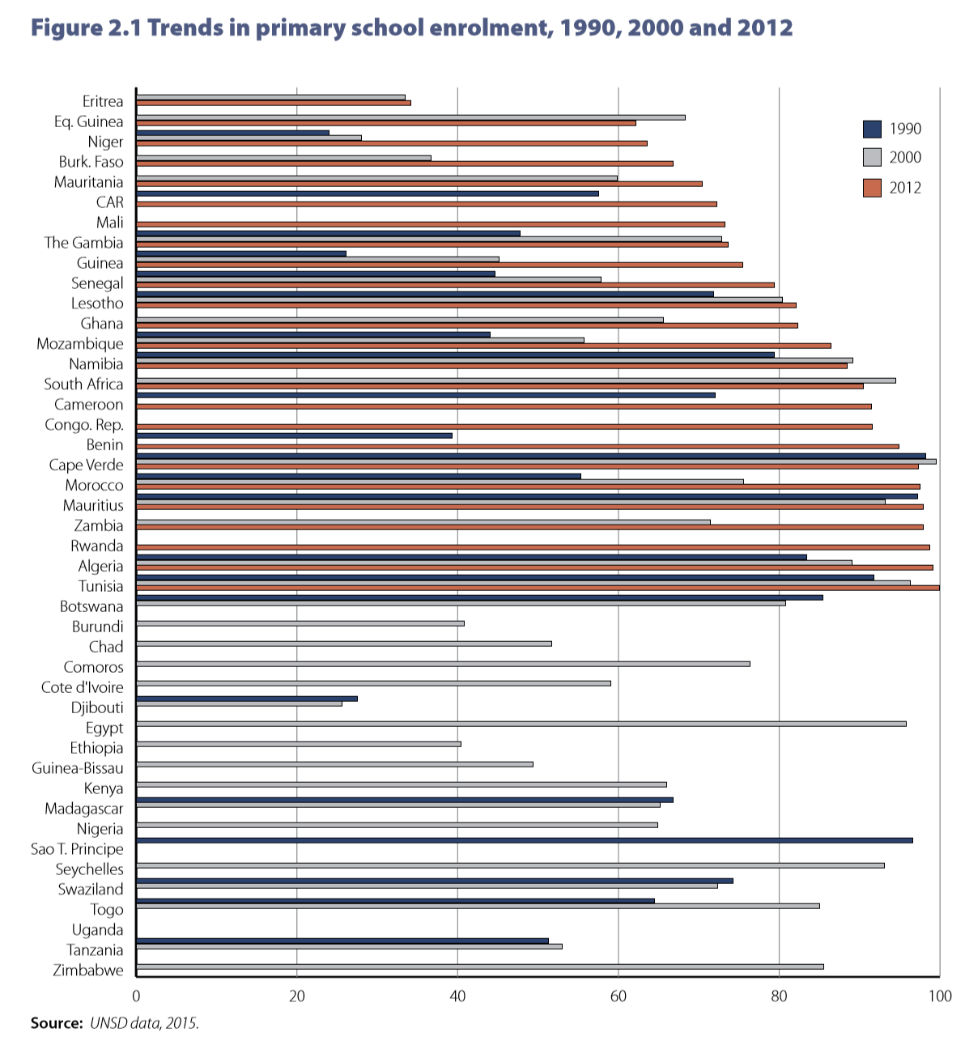
Goal 2: Achieve universal primary education.
Little progress.
Six out of ten eligible children are now in school. However, the increase is small and there are still a lot to do for further improvement.

Slide 26
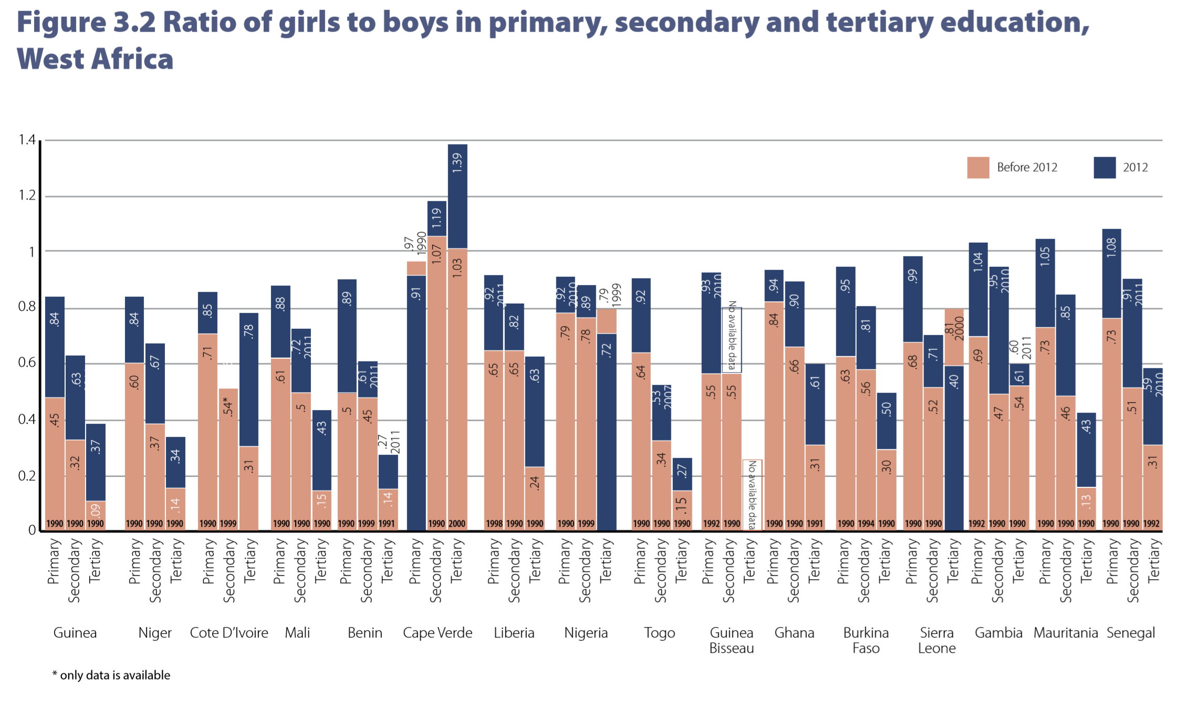
Goal 3: Promote gender equality and empower women.
Average progress:
There is almost no gender inequality here.

Slide 27
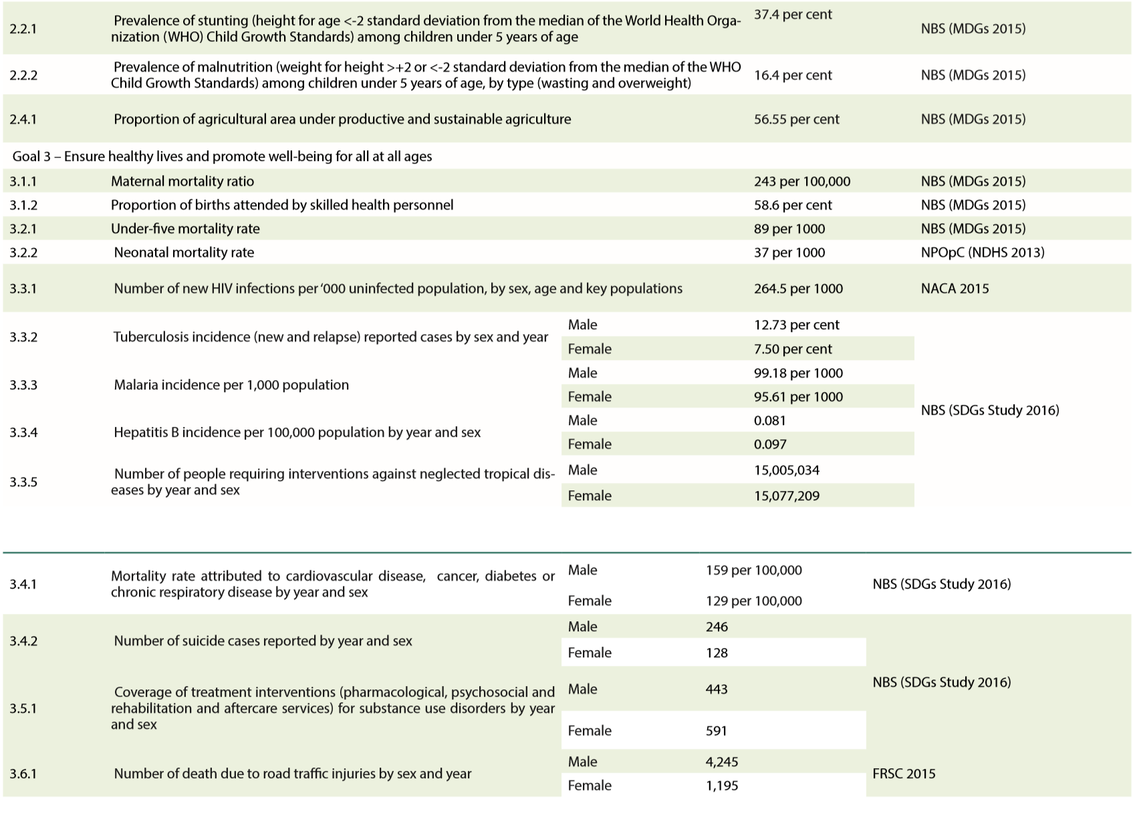
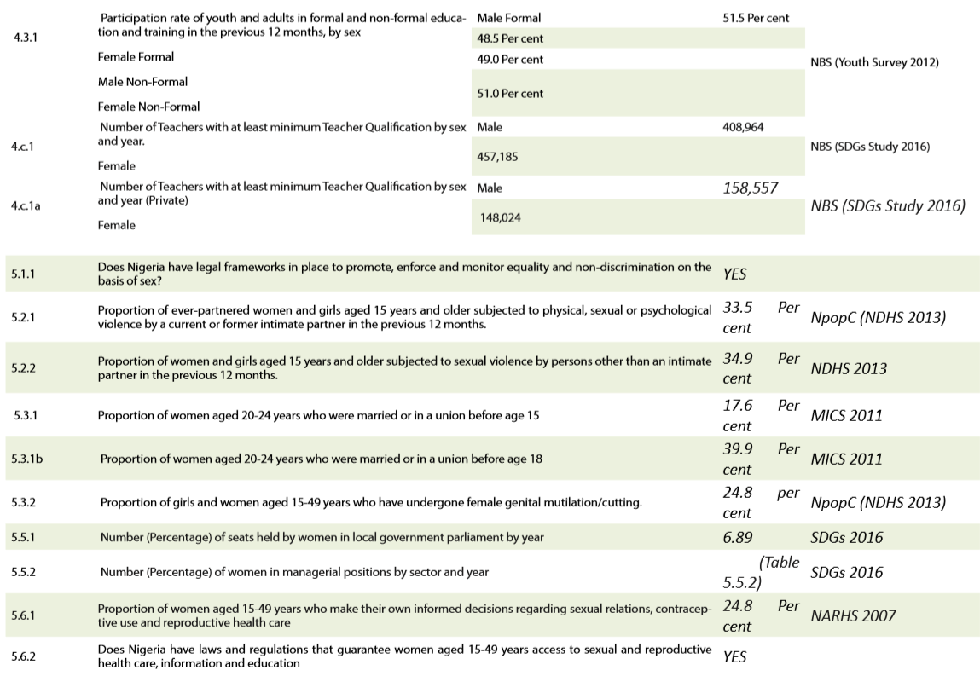
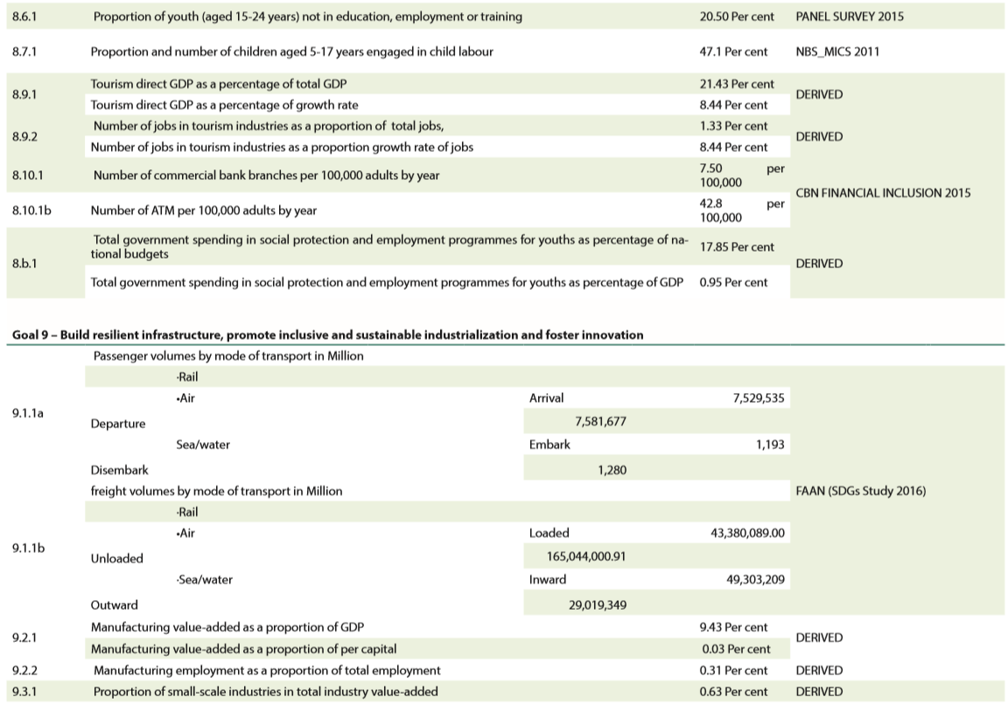
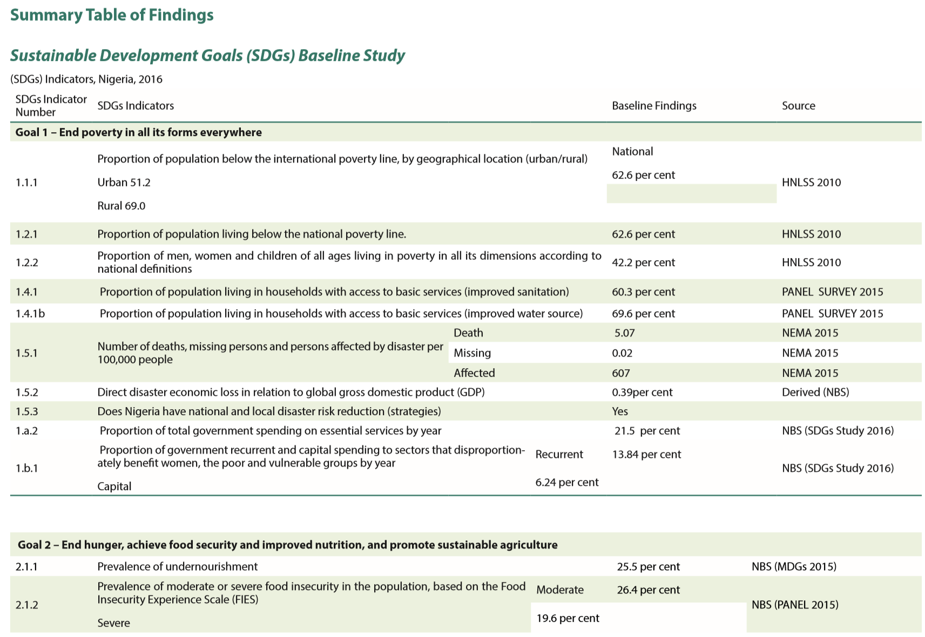
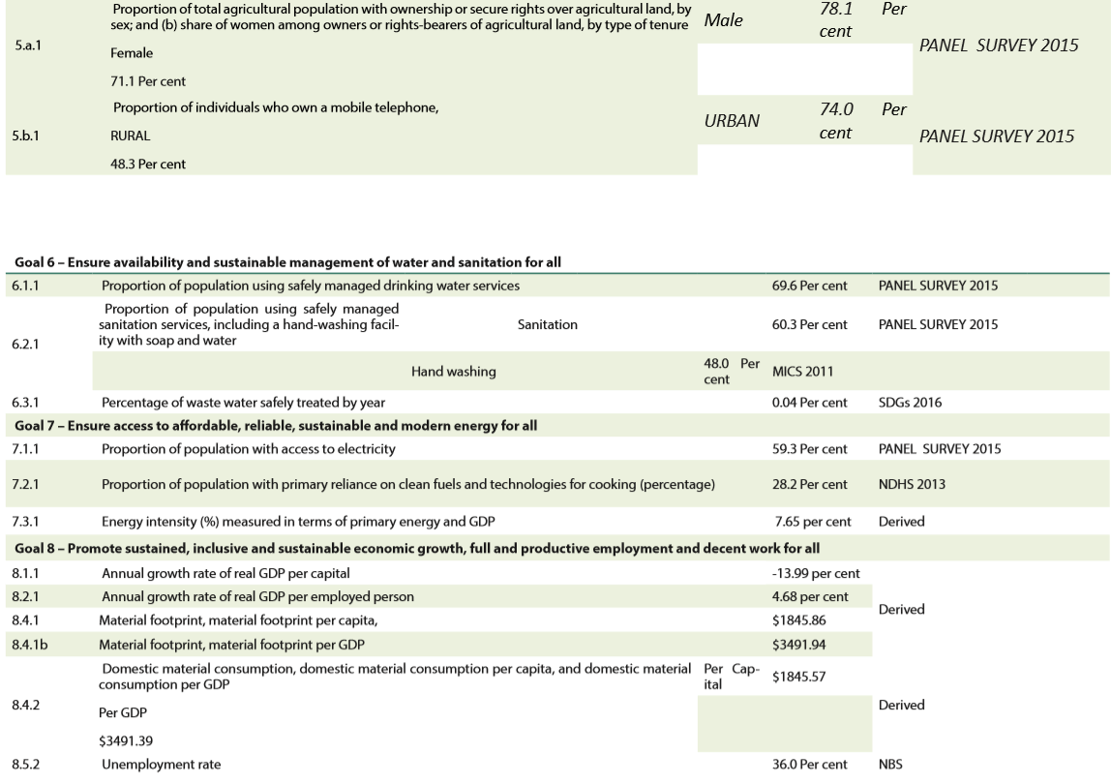
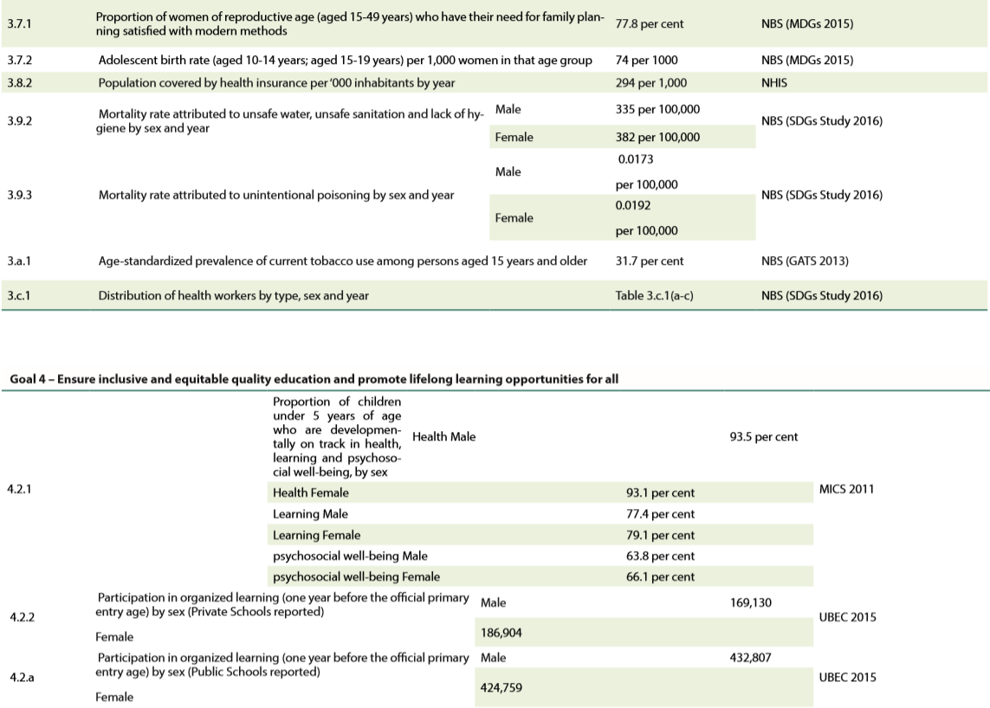
8. SDG (NBS)

Slide 28
9. the greatest cause for concern
1. inflation—leading to high unemployment, low efficiency and low GDP growth.
2. poverty—reflected through GDP per capita HDI value, and 6 out ten Nigerian still live in poverty according to the goal of SDG.
3. insecurity—still a lot wars and corruptions in the country, slowing down the development in certain areas.

Slide 29
Works cited
“Crude Oil Prices Over the Decade”. Macrotrends, 2019, https://www.macrotrends.net/1369/crude-oil-price-history-chart, accessed on 24 Feb. 2019.
Economic Commission for Africa. MDG Report 2015: Assessing Progress in Africa toward the Millennium Development Goals, 2015, https://www.afdb.org/fileadmin/uploads/afdb/Documents/Publications/MDG_Report_2015.pdf, accessed on 24 Feb. 2019.
“Nigeria.” Wikipedia, Wikimedia Foundation, 22 Feb. 2019, en.wikipedia.org/wiki/Nigeria#Geography, accessed on 24 Feb. 2019.
The National Bureau of Statistics. NIGERIA Sustainable Development Goals (SDGs) Indicators Baseline Report 2016. 2017, file:///C:/Users/Maggie%20Huang/AppData/Local/Packages/Microsoft.MicrosoftEdge_8wekyb3d8bbwe/TempState/Downloads/Nigeria%20SDGs%20Indicators%20Baseline%20Report%202016.pdf, accessed on 24 Feb. 2019.
The World Bank, https://data.worldbank.org/indicator/EN.ATM.CO2E.PC?end=2014&locations=NG&start=2004, accessed on 24 Feb. 2019.
The United Nations Development Program. Human Development Indices and Indicators 2018 Statistical Update, http://hdr.undp.org/sites/default/files/2018_summary_human_development_statistical_update_en.pdf, accessed on 24 Feb. 2019.
“Top 10 Oil Producing Countries in Africa”, Africa Facts, https://africa-facts.org/top-10-oil-producing-countries-in-africa/, accessed on 24 Feb. 2019.

